Slide 1

Customer Shopping Behavior Analysis
Analysis of 3,900 transactions to reveal spending patterns, segments, product preferences, and subscription behavior to inform strategy.

Slide 2
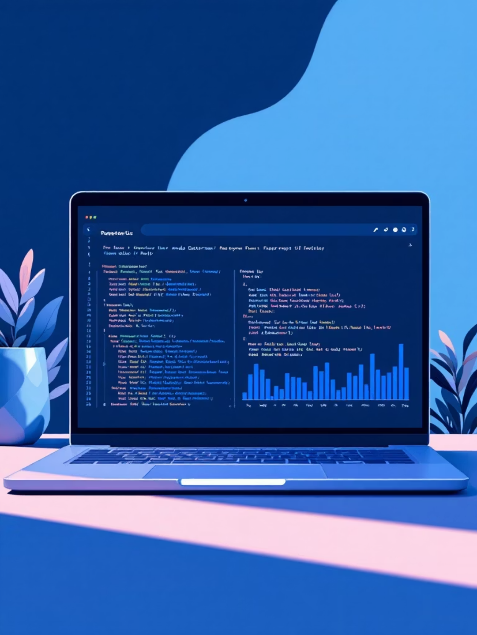
Dataset Snapshot
Rows: 3,900 · Columns: 18
Key features: demographics, purchase details, behavior signals (discounts, promos, frequency, ratings). Missing: 37 review ratings.
Average purchase amount: $59.76 · Avg review rating: 3.75

Slide 3
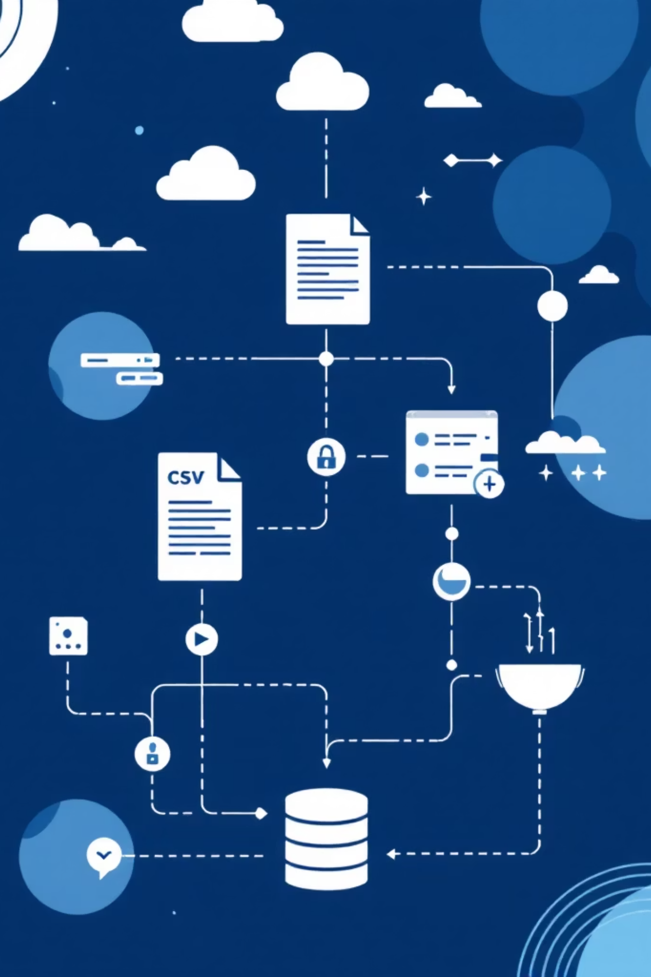
Data Preparation Highlights
Loading & Exploration
Missing Values
Imported with pandas; used df.info() and .describe() for structure and summaries.
Imputed 37 null review ratings using median per product category.
Standardization
Feature Engineering
Renamed columns to snake_case for readability and docs.
Added age_group and purchase_frequency_days derived from timestamps.

Slide 4

Database Integration & Cleaning Decisions
Decisions
Dropped redundant promo_code_used after checking correlation with discount_applied.
Loaded cleaned DataFrame into SQL Server for SQL analysis.

Slide 5


Revenue Insights — SQL Findings
By Gender
Male revenue: 157,890 · Female revenue: 75,191
By Age Group
Young Adult: 62,143 · Middle-aged: 59,197 · Adult: 55,978 · Senior: 55,763
Shipping Comparison
Standard avg: $58.46 · Express avg: $60.48

Slide 6


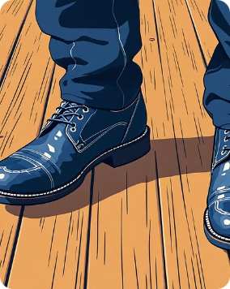
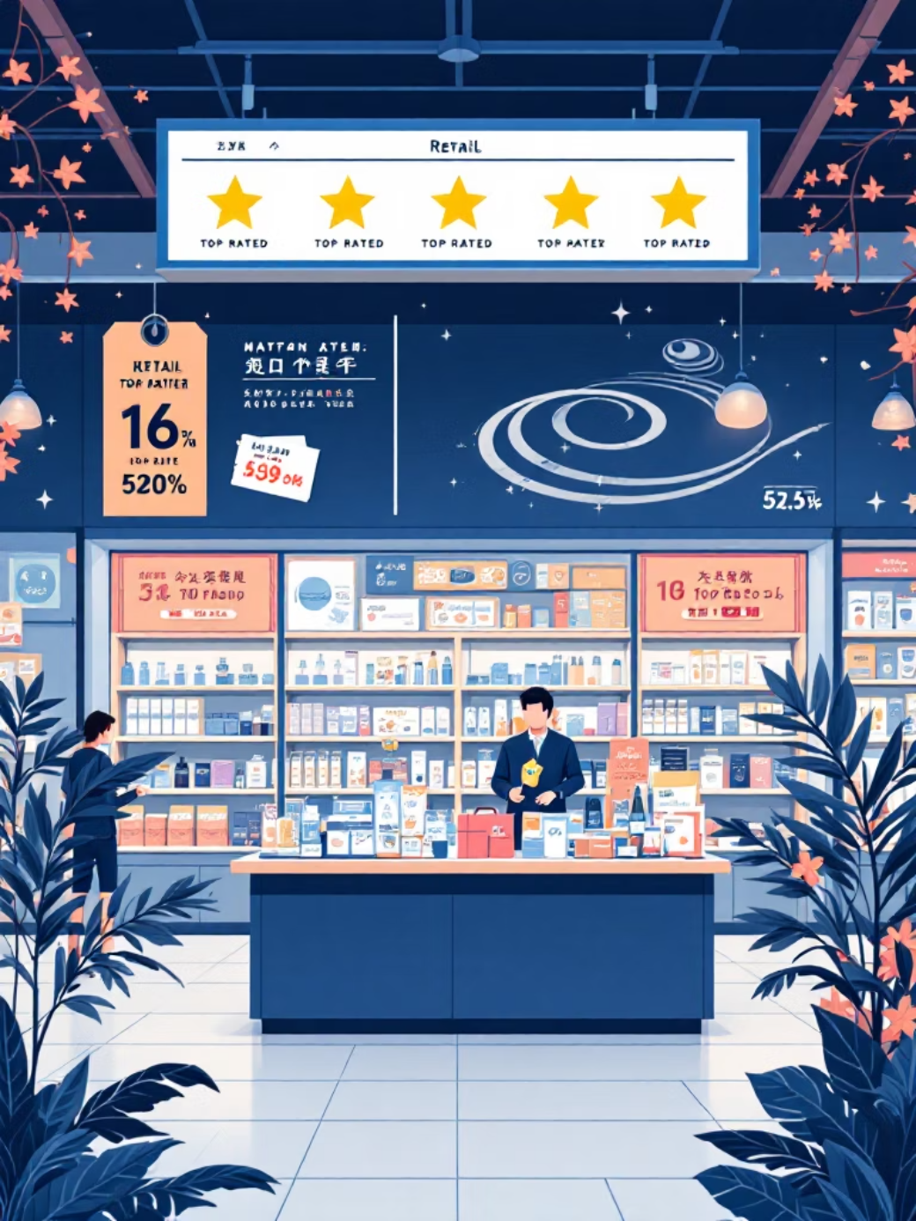


Top Products & Ratings
Top-rated items identified via SQL aggregation of review scores — useful for merchandising and promotional focus.
Gloves
Sandals
Boots
Avg rating: 3.86
Avg rating: 3.84
Avg rating: 3.82
Hat
Skirt
Avg rating: 3.80
Avg rating: 3.78

Slide 7
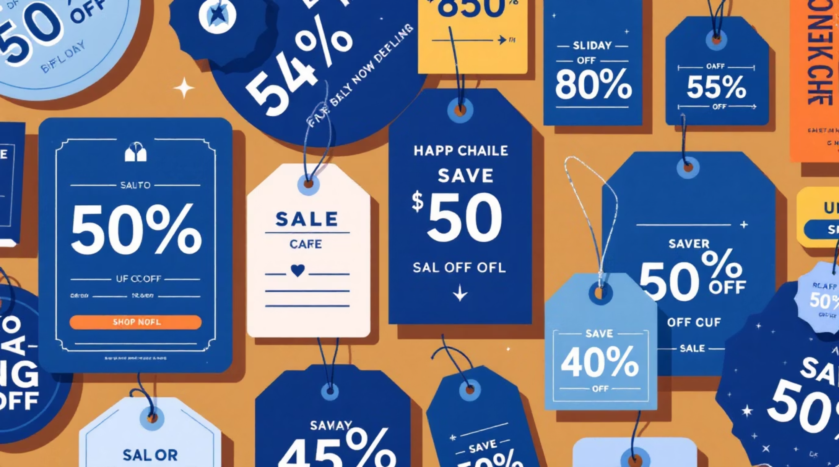
Purchase Behavior & Discounts
High-Spending Discount Users
839 rows identified where customers used discounts yet spent above average purchase amount.
Discount-Dependent Products
Highest discount rates: Hat 50.00% · Sneakers 49.66% · Coat 49.07% · Sweater 48.17% · Pants 47.37%

Slide 8

Customer Segmentation
Loyal
3,116 customers — primary revenue drivers and repeat buyers.
Returning
701 customers — growth opportunity to convert to loyal.
New
83 customers — onboarding and retention focus.

Slide 9

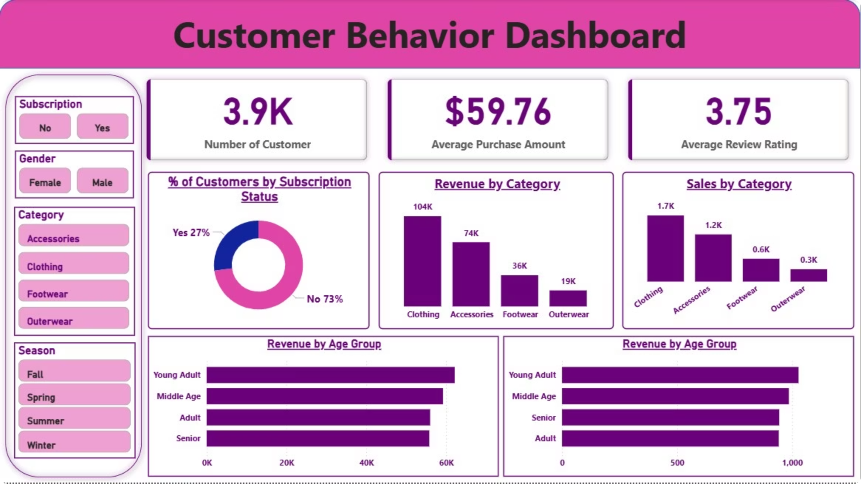
Power BI Dashboard Summary
Interactive dashboard shows: 27% subscribers vs 73% non-subscribers; Revenue by category — Clothing ~$100K, Accessories ~$70K, Footwear ~$30K, Outerwear ~$20K; Sales volume and age-group breakdowns for targeted action.

Slide 10
Business Recommendations
1
2
3
Boost Subscriptions
Loyalty Programs
Review Discount Policy
Promote exclusive subscriber benefits to increase recurring revenue; subscribers currently show meaningful avg spend.
Reward repeat buyers to grow the Loyal segment (3,116) and increase lifetime value.
Balance discount-driven sales with margin control; focus on products with high discount dependence.
4
5
Product Positioning
Targeted Marketing
Feature top-rated and best-selling items (Gloves, Sandals, Boots) prominently in campaigns.
Prioritize high-revenue age groups and express-shipping users for tailored promotions.

